Slide 1
Scalable Data Analytics
SENG 550
AKA. Big Data - Data Engineering
Armin Zirak

Slide 2
Data Quality
12

Slide 3
Why Data Quality Matters?
Imagine…
A food delivery system incorrectly marks alcoholic items as non-alcoholic -> legal issues.
A tax calculation service double-counts an amount -> double tax is deducted or paid.
A medical system mislabels a patient’s allergy -> risk to patient safety.
So bad quality dataset can have negative real world impacts…

Slide 4
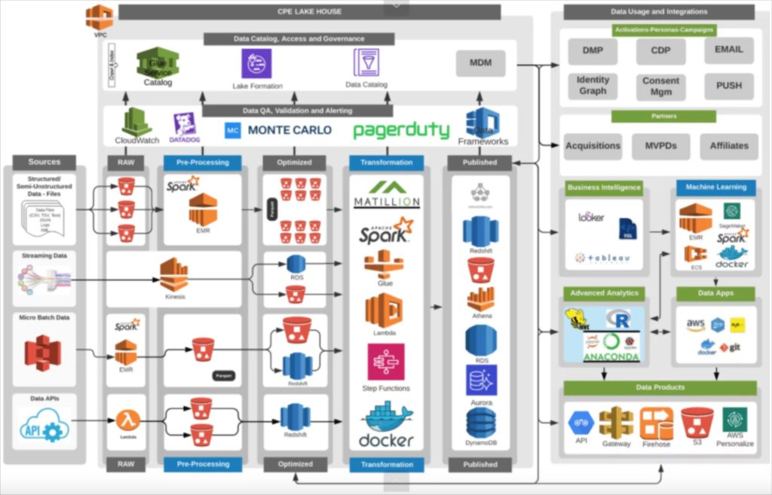
Data Quality issues are common
Modern data pipelines have many steps: ingestion, transformations, joins, denormalized tables, aggregations, batch + streaming.
Every data point is reappeared in lots of data stores in various formats. (raw orders -> cleaned orders -> enriched orders -> fact orders -> summarized orders)
Every step (pipeline) has a chance to introduce a bug in the dataset silently.

Slide 5
Errors Spread Quickly
When a dataset is buggy, the error can replicate in all downstreams.
Downstreams can be inside or outside your team
Downstreams can be outside the company
So, by the time you realize the issues, different tables at different stages and within different teams can be polluted.
It can become overly difficult to near impossible to fix the problems.

Slide 6
Examples
select o.*, c.country from orders as o
left join countries as c on c.city = c.country.
city | country
Toronto | Canada
Calgary | Canada
London | Canada
…
orders
orders with countries
enrichment
country mapping

Slide 7
Examples
select o.*, c.country from orders as o
left join countries as c on c.city = c.country.
city | country
Toronto | Canada
Calgary | Canada
London | Canada
London | UK
…
orders
duplicated orders with countries
enrichment
country mapping

Slide 8
Examples
select o.*, c.country from orders as o
left join countries as c on c.city = c.country.
Taxes for orders of London, Canada are also paid to UK
orders
duplicated orders with countries
enrichment
select sum(tax) from orders_with_countries where country = ‘UK’ -> to pay UK taxes
UK Tax
country mapping

Slide 9
Data Quality Dimensions
Uniqueness / Duplication: Is data unique on the key it’s supposed to be unique
City in the previous example
order_id in orders table
Freshness: Data is not stale or outdated.
Does the latest order in orders have a very recent timestamp?
select current_timestamp() - max(order_time) from orders
Keys match (referential integrity).
Are all the foreign keys presented in the relevant orders?
Is the city field on all orders presented in the city_country_mapping?
If not, we’re going to miss those orders in tax calculated.
Not null: Is there null values in the not nullable fields?
City in the orders must be not null.

Slide 10
Data Quality Dimensions
Accepted values: The categorical values are from the accepted values.
Order status is one of the predefined values. ['placed', 'shipped', 'completed', 'returned']
Otherwise, …
Value ranges: The amounts are within predefined ranges.
Payment amounts aren’t negative.
0 < user.age < 150

Slide 11
Automated Data Quality Monitoring
To maintain high data quality, we develop tests that are scheduled to run frequently on datasets.
For example, if the below query returns anything, that’s a sign of duplicate data in orders.
select order_id
from orders
group by order_id
having count(‘*’) > 1;
select current_timestamp() - max(order_time) as latency from orders where latency > ‘5 minutes
These tests can alert the developers through emails, slack, etc so they can react.
The failures can be recorded for team’s awareness.
“Fail Fast” -> in cases, we run tests before the next step of the pipeline runs. If the test fails, the pipeline will be paused until developers address it.

Slide 12
Legal Requirements (SOX & Other Regulations)
In large organizations, especially those dealing with financial, customer, or personal data, laws often require strict data accuracy controls.
Companies must implement documented data quality checks (completeness, accuracy, integrity, reconciliation) on key datasets.
Internal and external auditors (e.g., SOX auditors, SEC/OSC auditors) require evidence that
Tests are running
Issues are logged
Pipelines are monitored
If a data error affects customers (e.g., wrong billing, incorrect balances, inaccurate statements), companies may be legally required to notify reported customers, report the incident to regulators, perform investigation
Failure to maintain those regulations can lead to penalties and further legal risks.

Slide 13
Legal Requirements (SOX & Other Regulations)
SOX: Ensures financial data is accurate, traceable, and supported by strong internal controls for audits.
GDPR: Requires companies to keep personal data accurate and correct, with strict responsibilities for mistakes.
HIPAA: Protects medical information and demands accurate, consistent patient data to ensure safety.
PCI DSS: Enforces strict accuracy and integrity rules on credit card and payment transaction data.
No need to memorize the definitions for the exam.

Slide 14
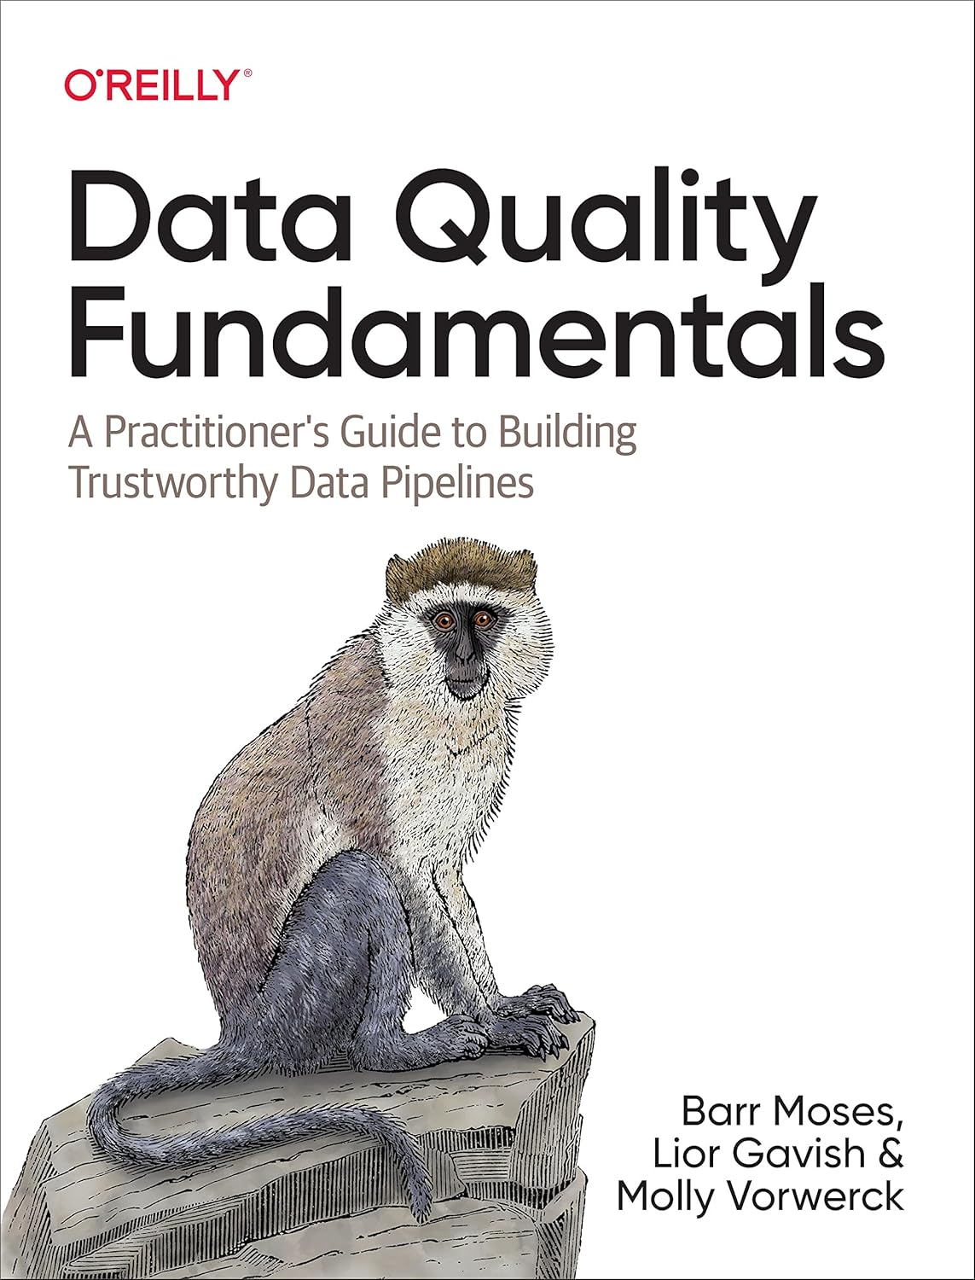
Legal Requirements (SOX & Other Regulations)
Data quality has recently become a major focus in modern data engineering. As pipelines grow more complex and decisions rely heavily on data, ensuring accuracy is now an essential and fast-growing topic in the industry.

Slide 15
Future

